Slide 1




Week-10 (Discussion)
30th September, 2024
Introduction to Machine Learning
Prof. Balaraman Ravindran
Professor and Head of the Department
Department of Data Science and Artificial Intelligence
IIT Madras
Ayan Paul
PMRF Research Scholar
IIT Kharagpur

Slide 2
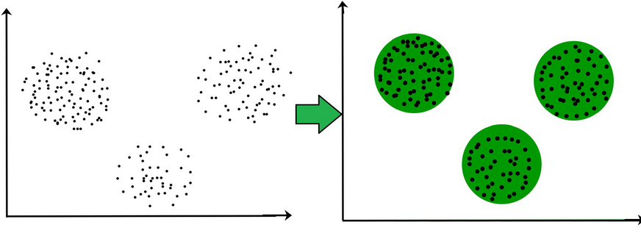
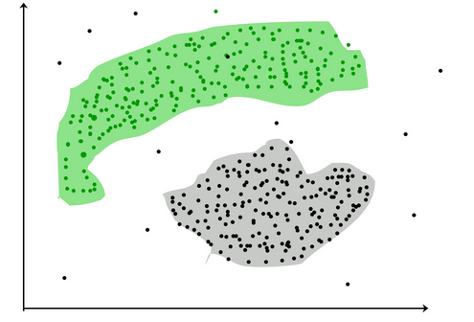
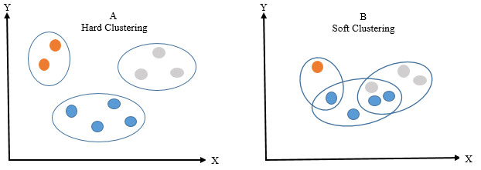
Limitation of Supervised Learning
In real world, not every data we work upon has a target variable. This kind of data cannot be analyzed using supervised learning algorithms.
We need the help of unsupervised algorithms.
Clustering
The task of grouping data points based on their similarity with each other is called Clustering or Cluster Analysis.
Clustering is done for:
Categorization
Pre-processing the data
Visualization
Type of Clustering based on Clusters Formed
1. Hard Clustering: In this type of clustering, each data point belongs to a cluster completely or not.
2. Soft Clustering: In this type of clustering, instead of assigning each data point into a separate cluster, a probability or likelihood of that point being that cluster is evaluated.

Slide 3
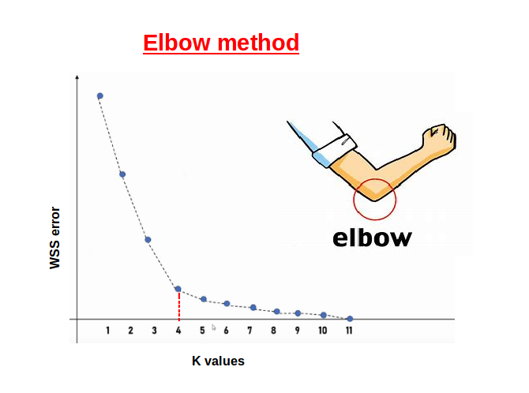
Type of Clustering based on Clustering Methods
1. Partitioning Clustering
Partitioning methods group data points on the basis of their closeness. Generally, the similarity measure chosen for these algorithms are Euclidian distance.
The datasets are separated into a predetermined number of clusters.
(i) K-Means Clustering
The K means algorithm takes the input parameter K from the user and partitions the dataset containing N objects into K clusters.
Each cluster is represented by its center (i.e, centroid) which corresponds to the mean of points assigned to the cluster.
Steps:
Randomly assign K objects from the dataset(D) as cluster centres(C)
(Re) Assign each object to which object is most similar based upon mean values.
Update Cluster means, i.e., Recalculate the mean of each cluster with the updated values.
Repeat Step 2 until no change occurs.

Slide 4

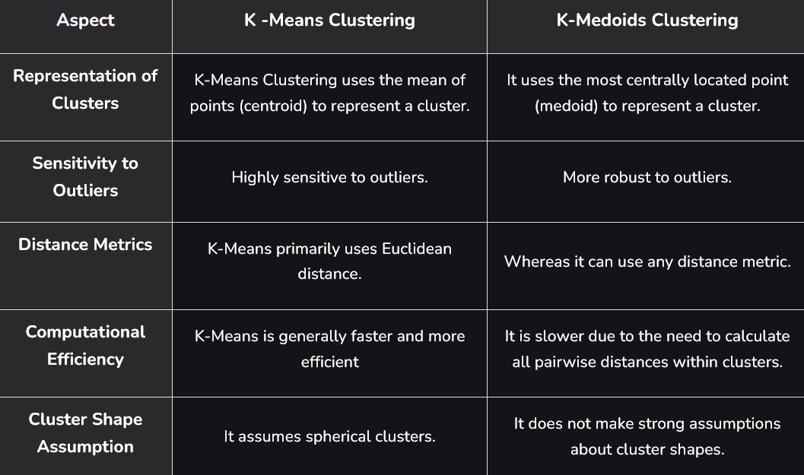
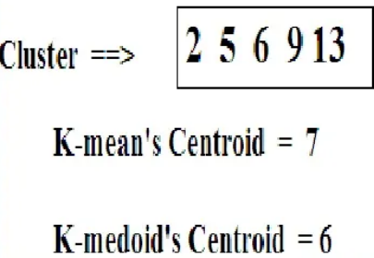
(ii) K-Medoids Clustering (PAM)
In K-medoids (also called partitioning around medoid) algorithm each cluster is represented by one of the data point in the cluster called medoids.
A medoid can be defined as the point in the cluster, whose similarities with all the other points in the cluster is maximum. It corresponds to the most centrally located point in the cluster.
Steps:
Initialize: select k random points out of the n data points as the medoids.
Associate each data point to the closest medoid by using any common distance metric methods.
Determine the cost of the points
For each medoid m, for each data o point which is not a medoid:
Swap m and o, associate each data point to the closest medoid, and recompute the cost.
If the total cost is more than that in the previous step, undo the swap.
Comparison of K-Means and K-Medoid

Slide 5
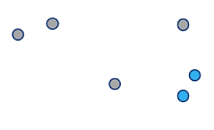
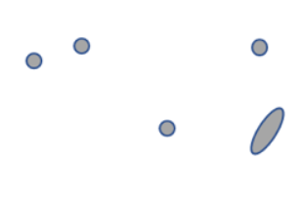
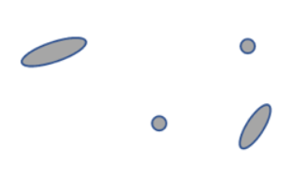
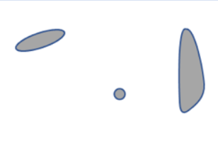
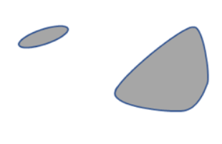
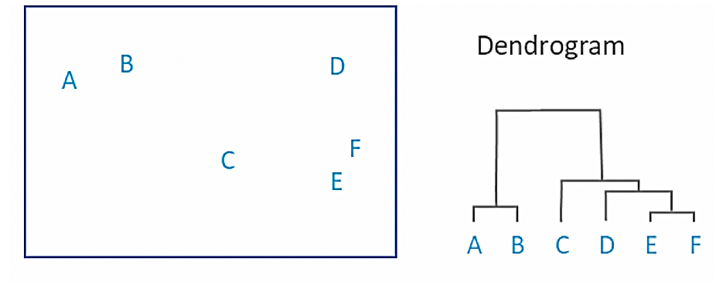
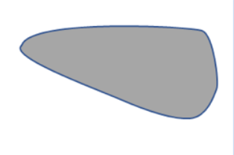
2. Hierarchical Clustering
In hierarchical clustering, each data point is initially taken into account as a separate cluster, which is subsequently combined with the clusters that are the most similar to form one large cluster that contains all of the data points.
Each object begins as its own cluster at the base of the tree when using hierarchical clustering, which creates a dendrogram, a tree-like structure.
The closest pairings of clusters are then combined into larger clusters after the algorithm examines how similar the objects are to one another.
When every object is in one cluster at the top of the tree, the merging process has finished.

Slide 6
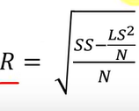
Limitation of Some Clustering Algorithm
Clustering algorithms like K-means clustering do not perform clustering very efficiently and it is difficult to process large datasets with a limited amount of resources (like memory or a slower CPU)
(i) BIRCH
Balanced Iterative Reducing and Clustering using Hierarchies (BIRCH) is a clustering algorithm that can cluster large datasets by first generating a small and compact summary of the large dataset that retains as much information as possible. This smaller summary is then clustered instead of clustering the larger dataset.
BIRCH summarizes large datasets into smaller, dense regions called Clustering Feature (CF) entries.
CF: Clustering Feature entry is defined as an ordered triple, (N, LS, SS) where ‘N’ is the number of data points in the cluster, ‘LS’ is the linear sum of the data points and ‘SS’ is the squared sum of the data points in the cluster.
CF Tree: A CF tree is a tree where each leaf node contains a sub-cluster. Every entry in a CF tree contains a pointer to a child node and a CF entry made up of the sum of CF entries in the child nodes. There is a maximum entry (radius) allowed in each leaf node. This maximum number is called the threshold.
BIRCH has one major drawback – it can only process metric attributes. A metric attribute is any attribute whose values can be represented in Euclidean space i.e., no categorical attributes should be present.

Slide 7
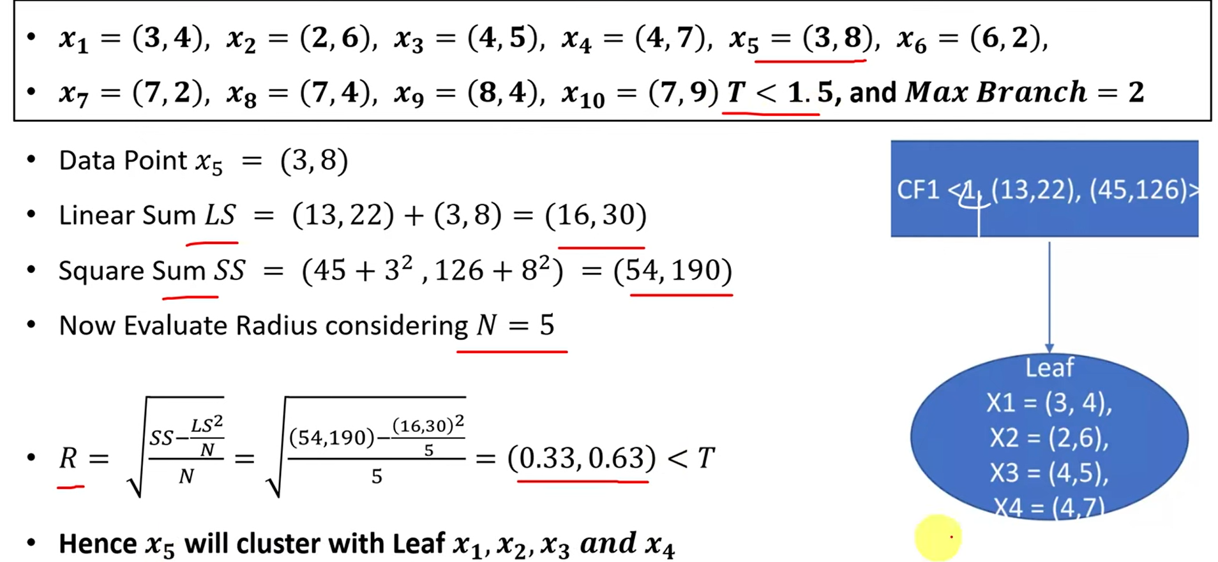
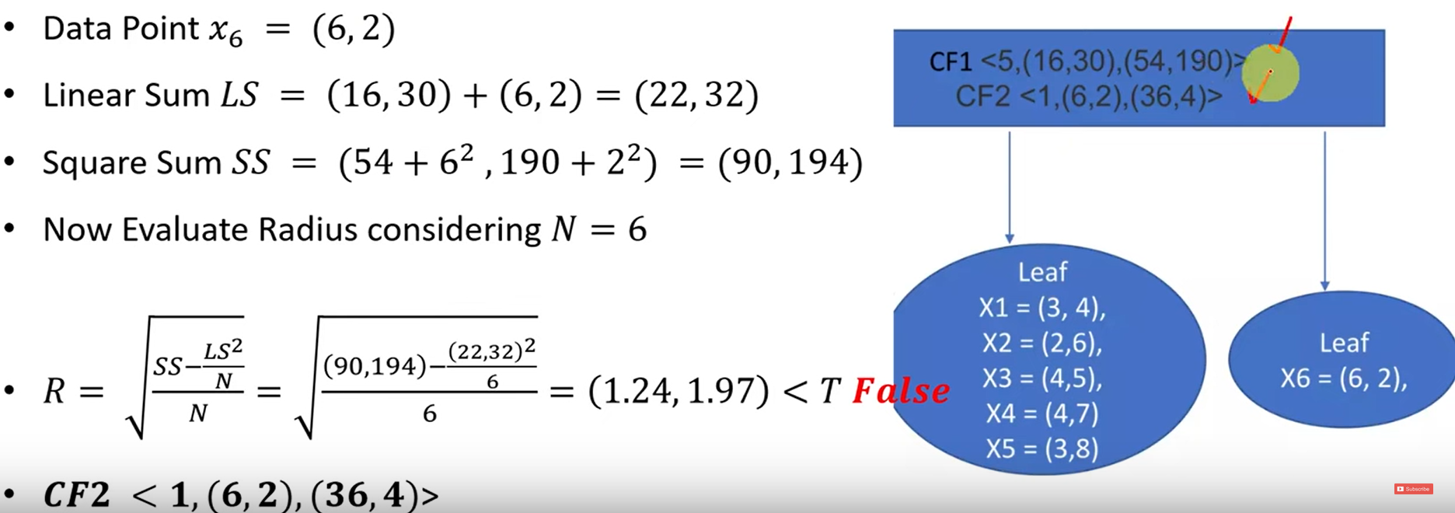
Numerical Approach to BIRCH

Slide 8
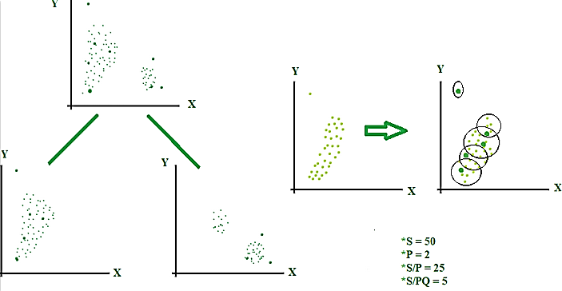
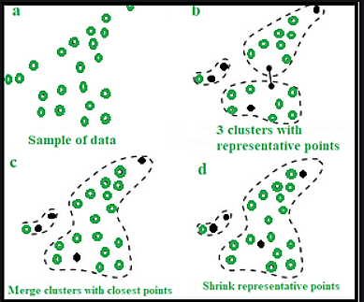
(ii) CURE
CURE(Clustering Using Representatives) is a hierarchical based clustering technique, that adopts a middle ground between the centroid based and the all-point extremes.
Instead of using one point centroid, as in most of data mining algorithms, CURE uses a set of well-defined representative points, for efficiently handling the clusters and eliminating the outliers.
Idea:
Random sample, say ‘s’ is drawn out of a given data.
This random sample is partitioned, say ‘p’ partitions with size s/p.
The partitioned sample is partially clustered, into say ‘s/pq’ clusters.
Outliers are discarded/eliminated from this partially clustered partition.
The partially clustered partitions need to be clustered again. Label the data in the disk.
Steps:
Choose a target number of points 'gfg' to represent each cluster.
Pick 'gfg' points that are well-scattered within the cluster.
Move the selected points towards the cluster’s centroid to reduce the effects of outliers.
Use these shrunk points as representatives for the cluster.
Calculate the minimum distance (Dmin) between the scattered points inside the cluster and points from other clusters. Merge the cluster with the nearest point (smallest Dmin).
After merging, update representative points for the new cluster.
Repeat the process until the desired number of clusters 'k' is achieved.

Slide 9
3. Density-based Clustering
Density-based clustering, a model-based method, finds groups based on the density of data points.
Contrary to centroid-based clustering, which requires that the number of clusters be predefined and is sensitive to initialization, density-based clustering determines the number of clusters automatically and is less susceptible to beginning positions.
They are great at handling clusters of different sizes and forms, making them ideally suited for datasets with irregularly shaped or overlapping clusters.
DBSCAN
The key idea of The Density-Based Spatial Clustering of Applications With Noise (DBSCAN) is that for each point of a cluster, the neighborhood of a given radius has to contain at least a minimum number of points.
Parameters
eps: It defines the neighborhood around a data point, i.e. if the distance between two points is lower or equal to ‘eps’ then they are considered neighbors.
MinPts: Minimum number of neighbors (data points) within eps radius. The minimum value of MinPts must be chosen at least 3.

Slide 10
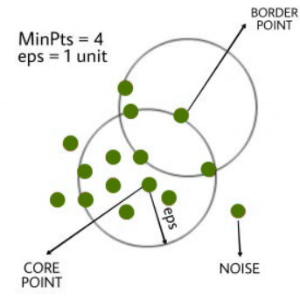
Types of Points in DBSCAN
Core Point: A point is a core point if it has more than MinPts points within eps.
Border/Boundary Point: A point which has fewer than MinPts within eps but it is in the neighborhood of a core point.
Noise or outlier: A point which is not a core point or border point.
Steps:
Find all the neighbor points within eps and identify the core points or visited with more than MinPts neighbors.
For each core point if it is not already assigned to a cluster, create a new cluster.
Find recursively all its density-connected points and assign them to the same cluster as the core point. A point a and b are said to be density connected if there exists a point c which has a sufficient number of points in its neighbors and both points a and b are within the eps distance. This is a chaining process. So, if b is a neighbor of c, c is a neighbor of d, and d is a neighbor of e, which in turn is neighbor of a implying that b is a neighbor of a.
Iterate through the remaining unvisited points in the dataset. Those points that do not belong to any cluster are noise.

Slide 11
Topics on which Week 10 Assignment Questions are based
Clustering
Partitional Clustering
Hierarchical Clustering
Density Based Clustering

Slide 12
QUESTION 1
K-means algorithm is not a particularly sophisticated approach for Image Segmentation tasks.
Choose the best possible explanation from below which supports the claim:
(a) It takes no account of the spatial proximity of different pixels.
(b) The curse of dimensionality does not affect the performance of K-means algorithm, as it
effectively handles high-dimensional data with minimal loss of accuracy.
(c) The algorithm requires the number of clusters (K) to be specified beforehand.
(d) Initialization does not affect K-means.
SOLUTION 1
If we go through the principle algorithm for k-means, we can infer the problems associated to high-dimensionality of the image and the fact that the number of clusters are needed to be known apriori to facilitate Image segmentation using k-means.
CORRECT ANSWER 1
a), c)

Slide 13
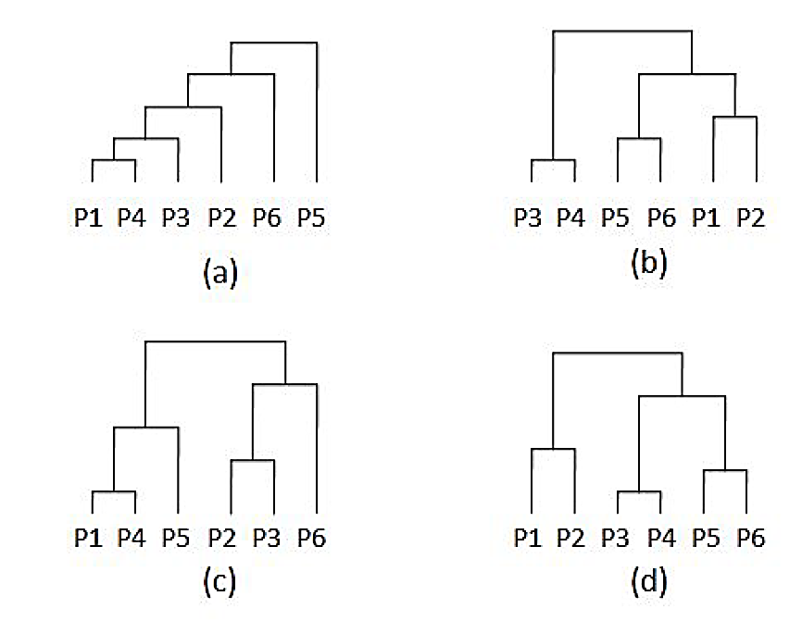
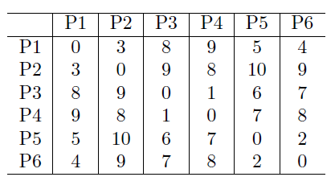
QUESTION 2
The pairwise distance between 6 points is given below. Which of the option shows the hierarchy of clusters created by single link clustering algorithm?
SOLUTION 2
Step 1: Connect closest pair of points. Closest pairs are:
d(P3, P4) = 1
d(P5, P6) = 2
d(P1, P2) = 3
Step 2: Connect clusters with single link. The cluster pair to combine is bolded:
d({P1, P2}, {P3, P4}) = 8
d({P1, P2}, {P5, P6}) = 4
d({P5, P6}, {P3, P4}) = 6
Step 3: Connect the final 2 clusters
CORRECT ANSWER 2
b)

Slide 14
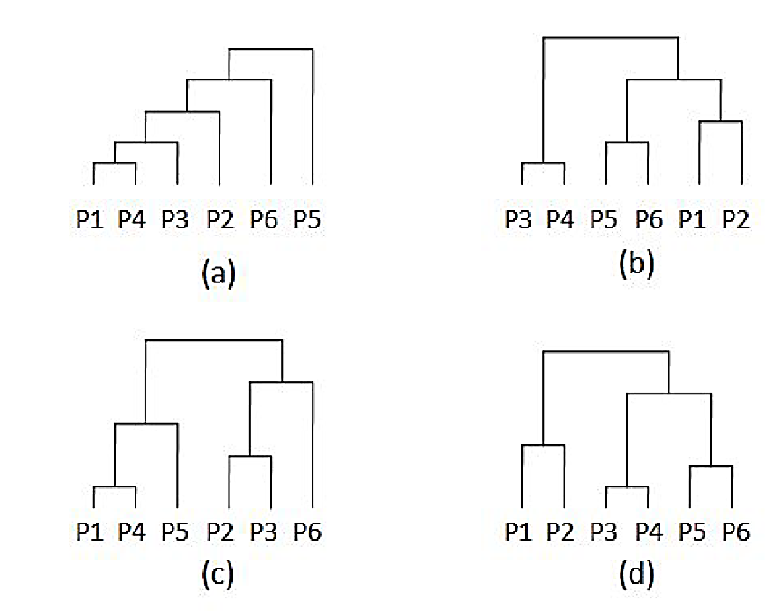
QUESTION 3
For the pairwise distance matrix given in the previous question, which of the following shows the hierarchy of clusters created by the complete link clustering algorithm?
SOLUTION 3
Step 1: Same as previous question
Step 2: Connect clusters with complete links. The cluster pair to combine is bolded:
d({P1, P2}, {P3, P4}) = 9
d({P1, P2}, {P5, P6}) = 10
d({P5, P6}, {P3, P4}) = 8
Step 3: Connect the final 2 clusters
CORRECT ANSWER 3
b)

Slide 15
QUESTION 4
Consider the following 3 points in a cluster : (2,1), (3,4), (5,7)
Computer the BIRCH Cluster Features (CF) for this cluster.
a. (4,5,15)
b. (5,13,200)
c. (3,(6,6),125)
d. (3,(10,12),104)
SOLUTION 4
CF = (3, (2+3+5, 1+4+7), (4+1+9+16+25+49)) = (3, (10, 12), 104)
CORRECT ANSWER 4
d)

Slide 16
QUESTION 5
Statement 1: CURE is robust to outliers.
Statement 2: Because of multiplicative shrinkage, the effect of outliers is dampened.
(a) Statement 1 is true. Statement 2 is true. Statement 2 is the correct reason for statement 1.
(b) Statement 1 is true. Statement 2 is true. Statement 2 is not the correct reason for statement 1.
(c) Statement 1 is true. Statement 2 is false.
(d) Both statements are false.
SOLUTION 5
CURE (Clustering Using Representatives) is a robust clustering algorithm that handles outliers well. Instead of focusing only on centroids or medoids, it uses multiple representative points to capture the geometry of clusters, making it less sensitive to outliers.
Multiplicative shrinkage refers to the method used in CURE where representative points are shrunk towards the cluster centroid. This shrinkage reduces the influence of outliers on the cluster shape, effectively dampening their effect.
Thus, both statements are true, and Statement 2 correctly explains why CURE is robust to outliers.
CORRECT ANSWER 5
a)

Slide 17
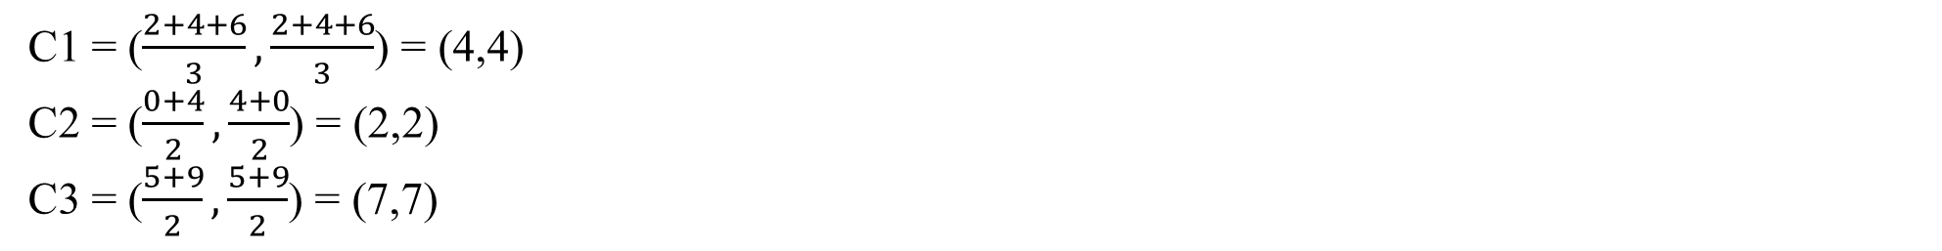
QUESTION 6
Assume you want to cluster 7 observations into 3 clusters using the K-Means clustering algorithm. After the first iteration, clusters C1, C2, C3 have following observations:
C1: {(2,2), (4,4), (6,6)}
C2: {(0,4), (4,0)}
C3: {(5,5), (9,9)}
What will be the cluster centroids if you want to proceed with the second iteration?
C1: (4,4), C2: (2,2), C3: (7,7)
C1: (6,6), C2: (4,4), C3: (9,9)
C1: (2,2), C2: (0,0), C3: (5,5)
None of these
SOLUTION 6
CORRECT ANSWER 6
a)

Slide 18
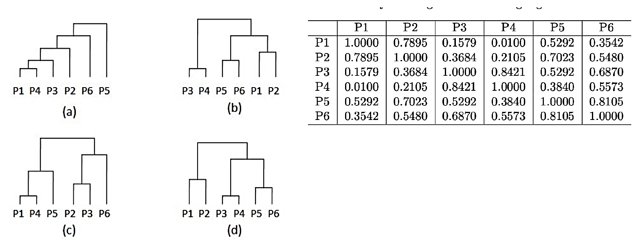
QUESTION 7
Consider the similarity matrix given below: Which of the following shows the hierarchy of clusters created by the single link clustering algorithm.
Step 1: Connect closest pair of points. Closest pairs are:
s(P3, P4) = 0.8421
s(P5, P6) = 0.8105
s(P1, P2) = 0.7895
Step 2: Connect clusters with single link. The cluster pair to combine is bolded:
s({P1, P2}, {P5, P6}) = 0.7023
s({P5, P6}, {P3, P4}) = 0.6870
s({P1, P2}, {P5, P6}) = 0.5480
Step 3: Connect the final 2 clusters
SOLUTION 7
CORRECT ANSWER 7
b)

Slide 19
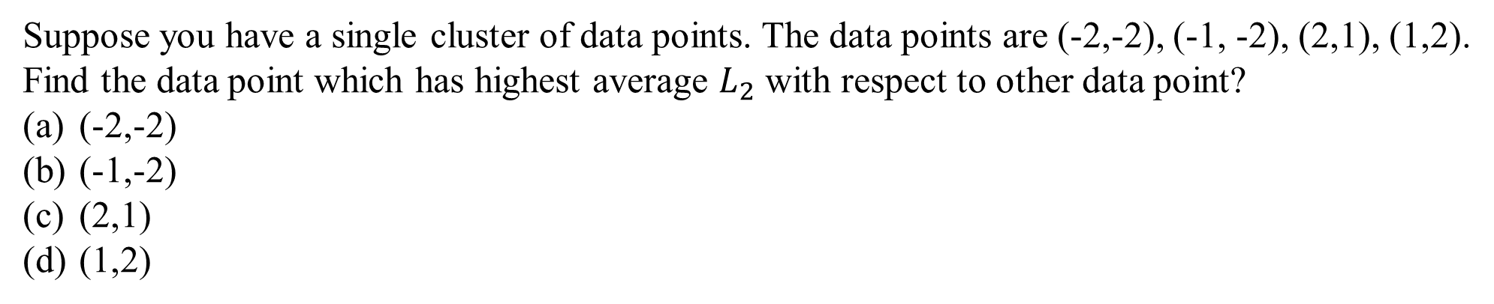
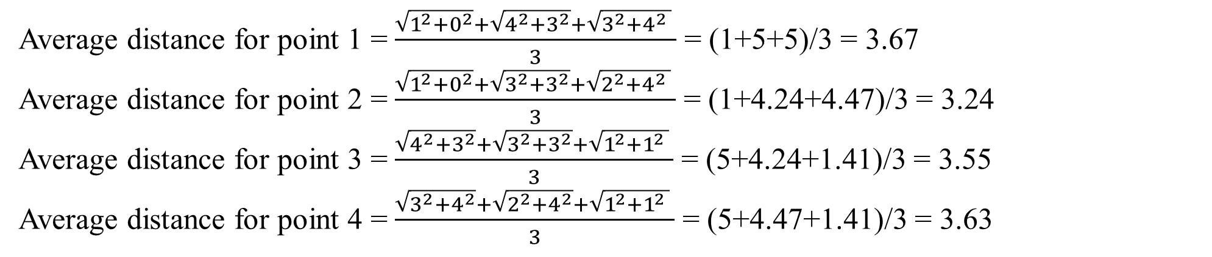
QUESTION 8
SOLUTION 8
CORRECT ANSWER 8
a)

Slide 20
QUESTION 9
Which of the following is/ are not true about the k-means clustering?
It is an unsupervised learning algorithm
Overlapping of clusters is allowed in k-means clustering
It is a hard-clustering technique
k is a parameter
SOLUTION 9
Overlapping of clusters is not allowed in k-means clustering as it is a hard clustering technique
CORRECT ANSWER 9
b)

Slide 21
QUESTION 10
Suppose while performing DBSCAN we randomly choose a point which has less than MinPts number of points in its neighborhood. Which among the following is true for such a point?
It is treated as noise and not considered further in the algorithm
It not considered as a border point
Depending upon the other points, it may be later turn into a core point
Depending upon the other points, it may be density connected to other points
SOLUTION 10
Since, there are less than MinPts number of points in neighborhood it is not a core point. However it cannot be considered a noise, since there exists a core point, whose neighborhood this point lies in, it can be a boundary point.
CORRECT ANSWER 10
d)

